Slide 1
ASP.NET Core

Slide 2
IWebHost
is the core of ASP.NET Core applications. It contains
the Application
Configuration
Kestrel server
that listens for requests
and sends responses

Slide 3
Building the IWebHost
A WebHostBuilder is used to create a Web server (host) and configure it.
Then the web server (IWebHost) is instantiated with a call to Build()
The configuration of the app’s services, and middleware pipeline are defined in a class called Startup which is referenced in the UseStartup<>() method

Slide 4
Configuration Components
Program
Startup
has the infrastructure configuration of the application, such as the HTTP server, integration with IIS, and config sources.
Defines the components, and the features which the application uses, and also the middleware pipeline for the app

Slide 5
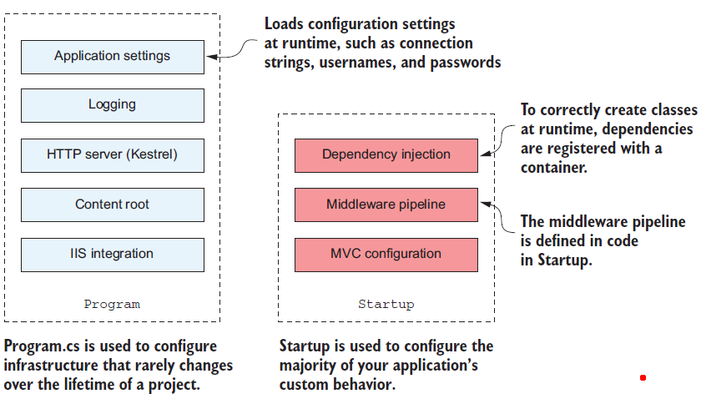

Slide 6
The Startup class

Slide 7
The Startup class is responsible for configuring two main aspects of the application
Service Registration
Middleware and MVC
All classes that the application depends on for providing Functionality must be registered so that they can be correctly instantiated at runtime. (those used by the framework and those specific to the application)
How the application handles and responds to requests

Slide 8
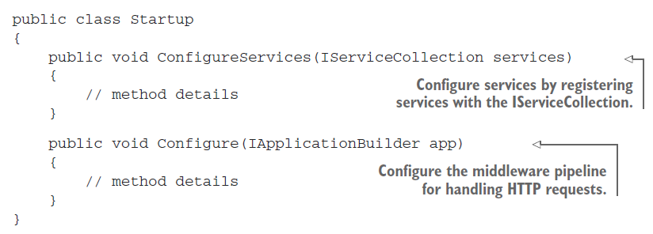

Slide 9
The WebHostBuilder created in Program calls
Services registered in ConfigureServices() are available to the Configure() method
ConfigureServices()
Configure()
Once configuration is complete, an IWebHost is created by calling Build() on the WebHostBuilder

Slide 10
Adding and configuring services
For each distinct feature ASP.NET Core uses small, modular components known as services.
This allows individual features to evolve separately, which is loosed coupled to others and are used by the application

Slide 11
Services
Within the context of ASP.Net Core, service refers to any class that provides functionality to an application and could be classes exposed by a library or code written for the application

Slide 12
IOC Container
Register the dependencies of the application into a “container,” which can then be used to create any service.
This is true for both custom application services and the framework services used by ASP.NET Core.
Each service must be registered with the container before it can be used in the application.
In an ASP.NET Core application, this registration is performed in the ConfigureServices method.

Slide 13
IServiceCollection
Whenever a new ASP.NET Core feature is used in the application it must be added in the necessary services.
The IServiceCollection is a list of every known service that the application will need to use. By adding a new service to it, we ensure that whenever a class declares a dependency on the service, the IoC container knows how to provide it

Slide 14
Defining how requests are handled with middleware
In the final configuration method of Startup, Configure(), we define the middleware pipeline for the
application, which defines the app’s behavior

Slide 15
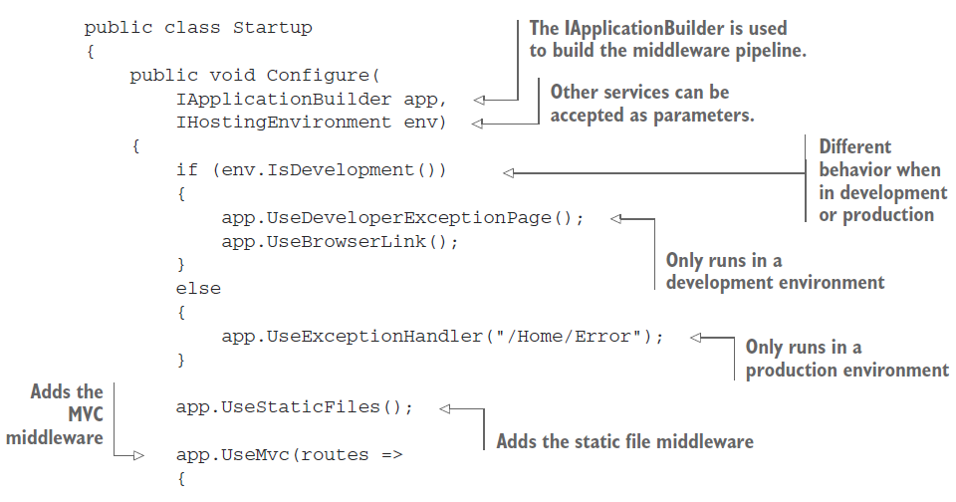
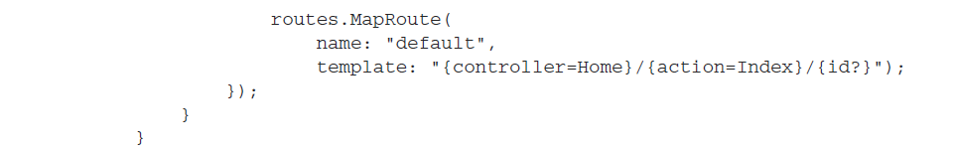

Slide 16
The IApplicationBuilder that is passed to the Configure() method is used to define the order in which middleware commands are executed
The order in which the calls are executed in the final pipeline depends on the order in which they are added to the builder.
Middleware nodes can only use objects created by the previous nodes in the pipeline. It can’t access objects to be created by later nodes
If we are performing authorization in middleware to restrict the users that may access the application, we must ensure it comes after the authentication node that identifies the current user

Slide 17
IHostingEnvironment
IHostingEnvironment parameter is used to provide different behavior when you’re in a development environment.
IHostingEnvironment is already set by the time Startup is invoked (properties/launchsetting.json);
These values can’t be changed using the application settings in Startup.
EnvironmentName is typically set externally by using an environment variable when your application starts.

Slide 18
The IHostingEnvironment object contains details about the current environment, as determined by the WebHostBuilder in Program.
It exposes a number of properties:
ContentRootPath —Location of the working directory for the app, typically the folder in which the application is running
WebRootPath —Location of the wwwroot folder that contains static files
EnvironmentName —Whether the current environment is a development or production environment

Slide 19
app.UseStaticFiles();
This middleware is responsible for handling requests for static files such as CSS files, JavaScript files, and images
When a request arrives at the middleware, it checks to see if the request is for an existing file
If not, the request is ignored and the next node of middleware can attempt to handle the request
If it is, then the middleware returns the file

Slide 20
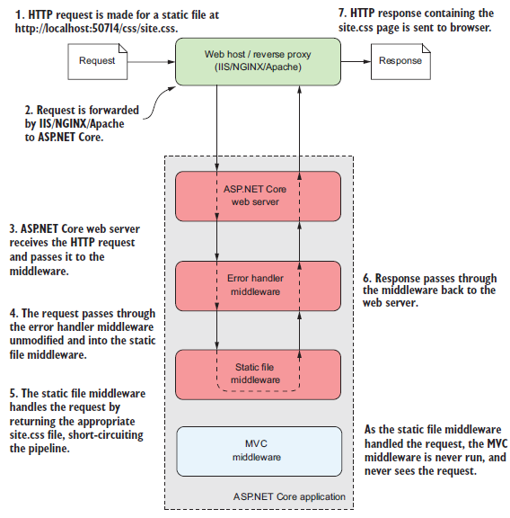

Slide 21


Slide 22
A
A
Program
Startup
has the infrastructure configuration of the application, such as the HTTP server, integration with IIS, and config sources.
Defines the components, and the features which the application uses, and also the middleware pipeline for the app
A
A
A
A
A
A
A
A

